Slide 1

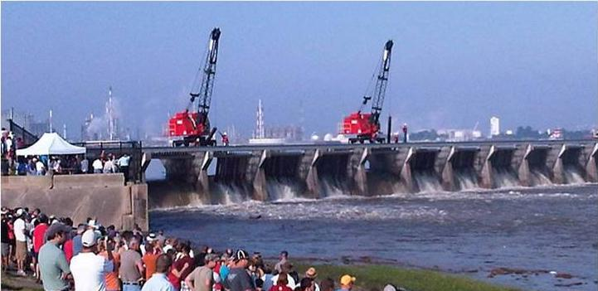
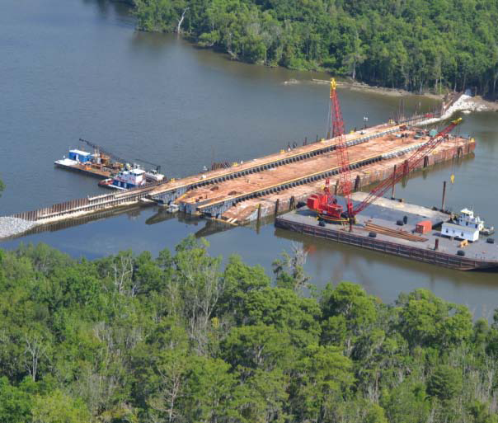

The Map-of-Everything: The Challenges of Supporting a Large Engineering Organization with GIS
Maik Flanagin PE PhD
New Orleans District
5 August 2019
US Army Corps of Engineers
BUILDING STRONG®
Notes:
Very brief overview of Freeboard/field data collection/MICA
Prototyping for Collector/ArcGIS REST
Integrating collector, pulling snapshots of data
QA data and integrate into reports
Diagram of data as it flows in and out of CorpsNet
Integration with ArcServer and Portal
Challenges
Future Plans
Questions

Slide 2
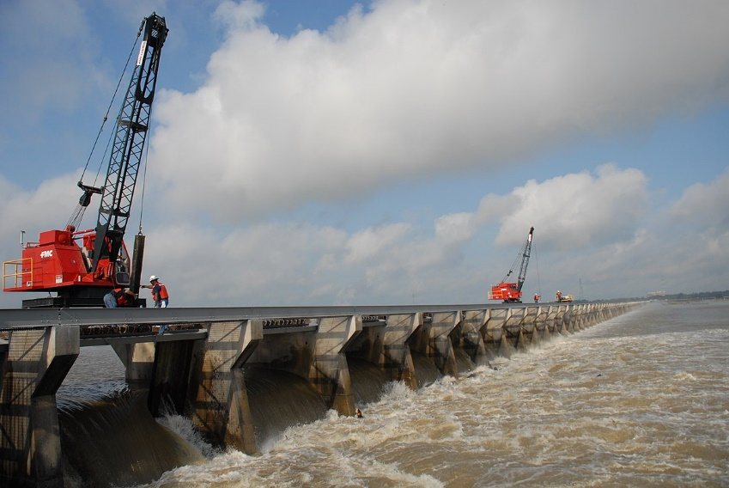

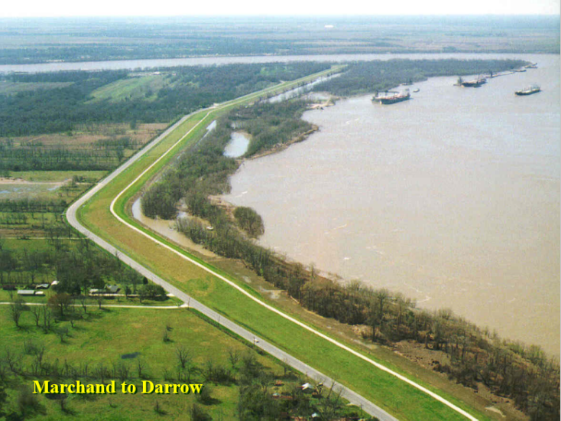
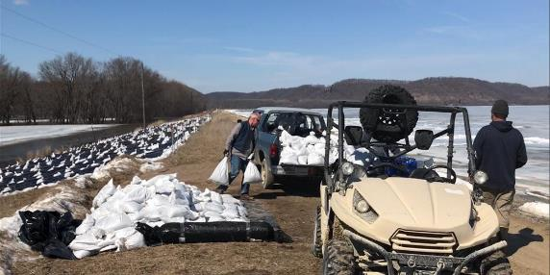
Corps of Engineers in Action

Slide 3
Corps Districts
MN
  ND
MI
WI
MINNEAPOLIS
ST. PAUL
St. Paul District
DUBUQUE
IA
ROCK ISLAND
IL
Rock Island District
IN
St. Louis District
KS
ST. LOUIS
MO
CAIRO
KY
Memphis District
OK
AR
TN
Vicksburg District
MEMPHIS
LITTLE ROCK
New Orleans District
AL
SHREVEPORT
LA
VICKSBURG
TX
JACKSON
MS
BATON ROUGE
NEW ORLEANS

Slide 4
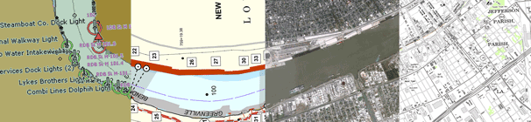
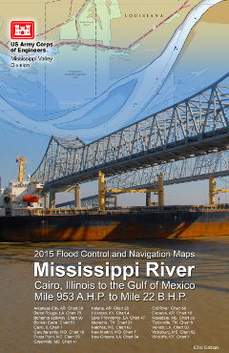

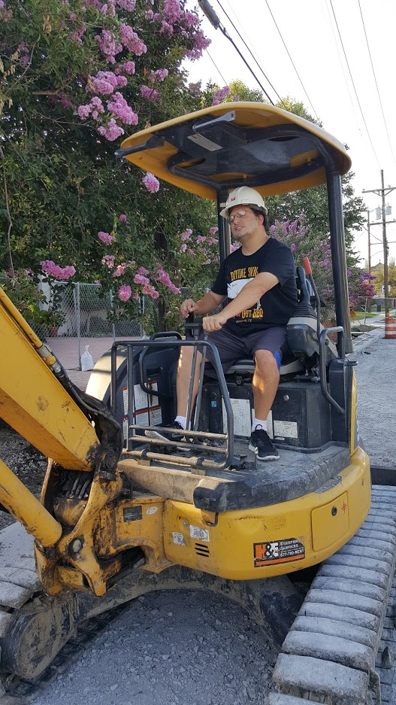
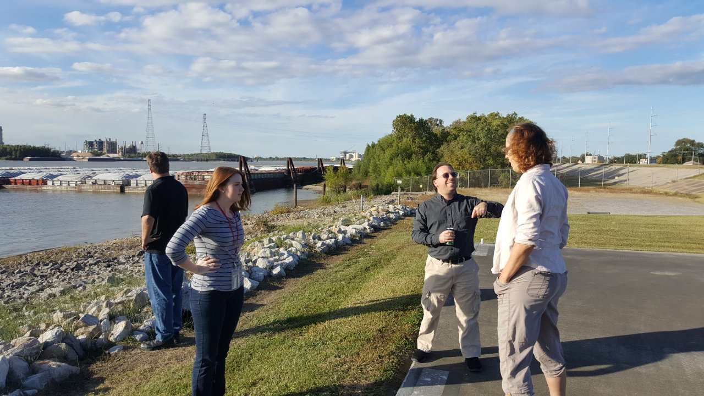
Geospatial Engineering Office

Slide 5
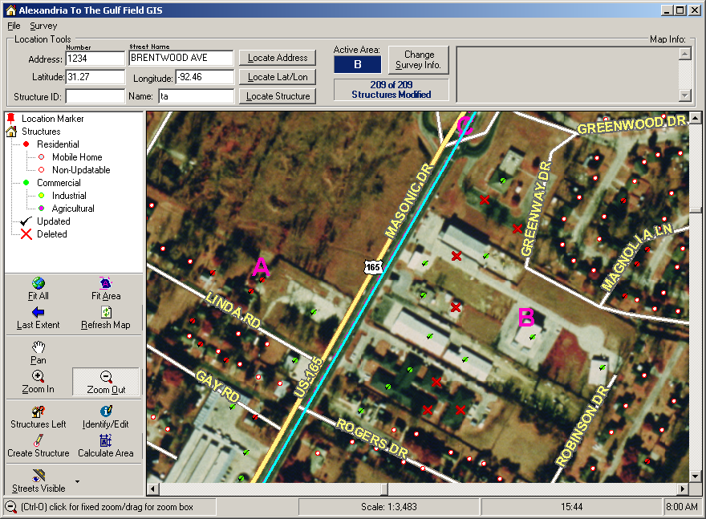
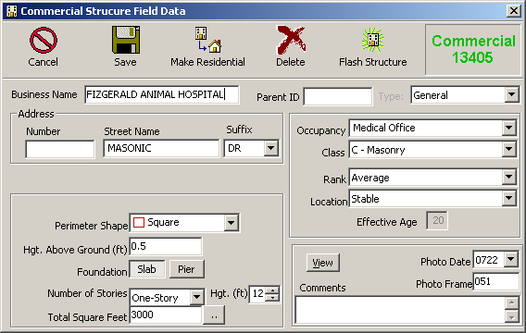

Structure Value GIS

Slide 6
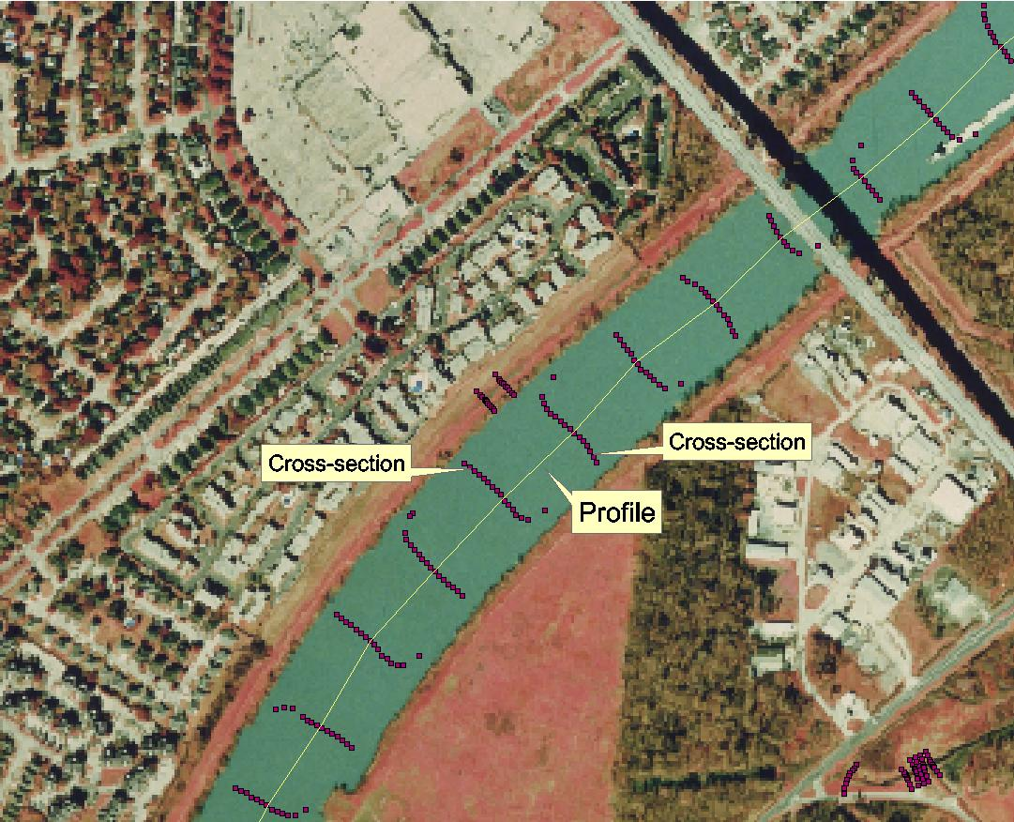
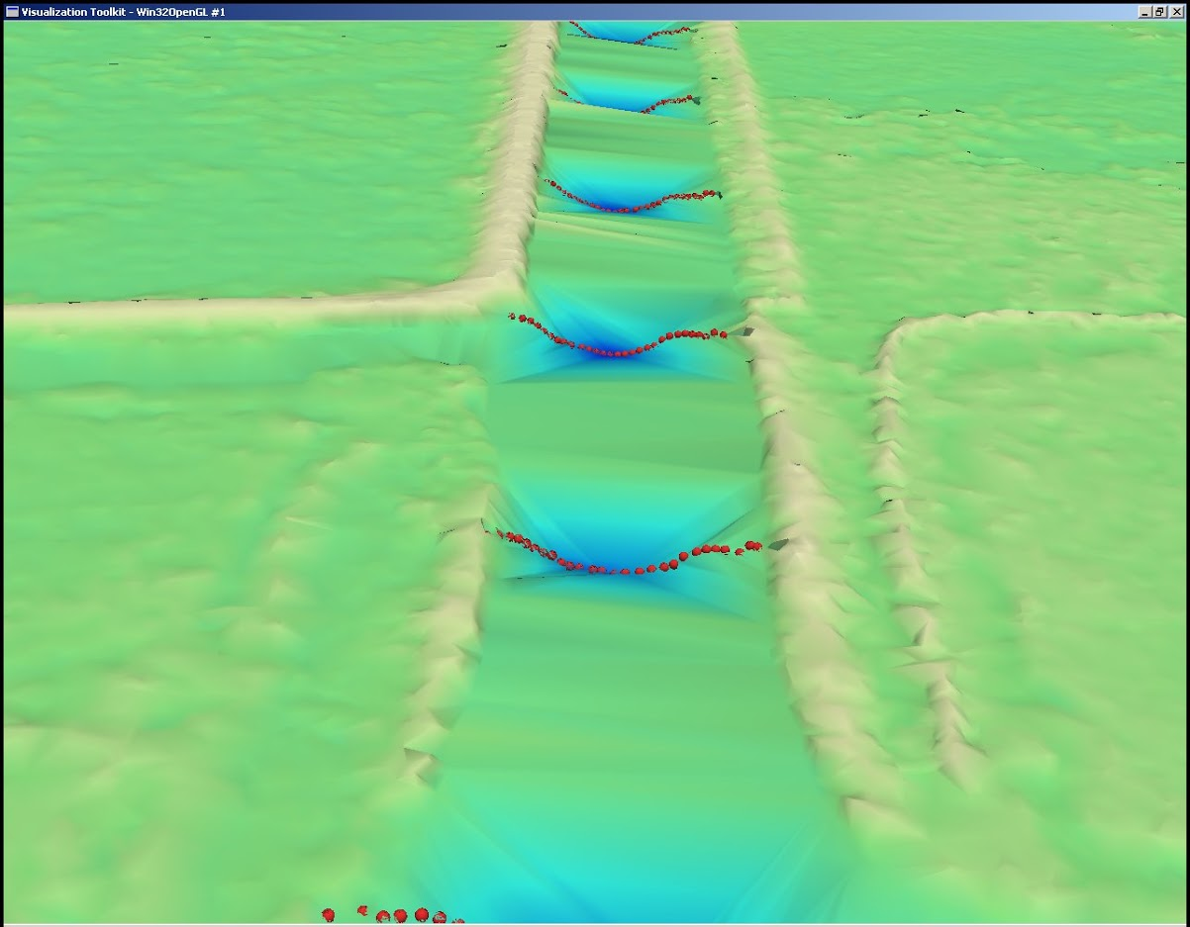
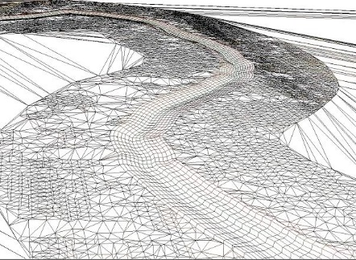
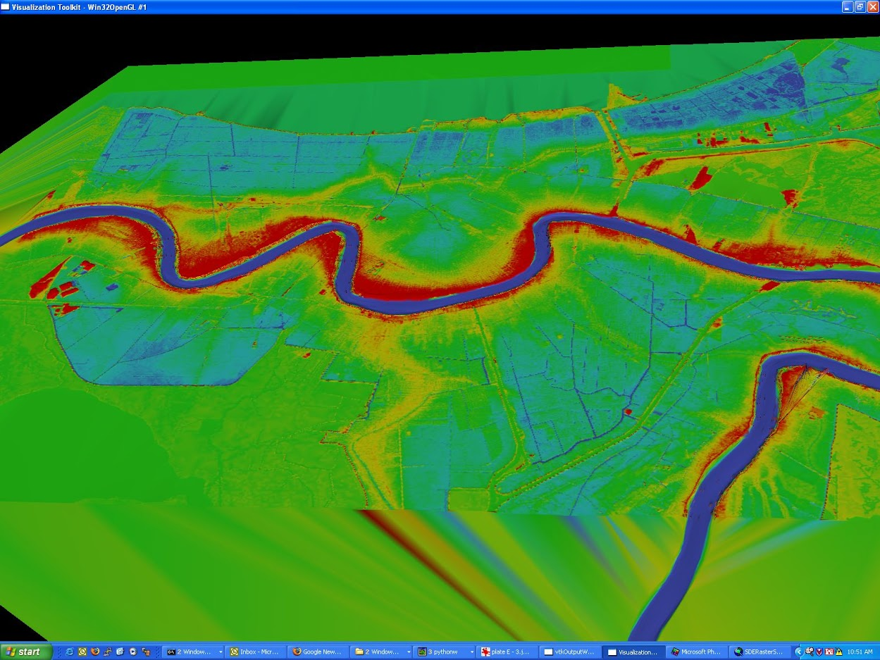
Hydraulic Spline Interpolation

Slide 7
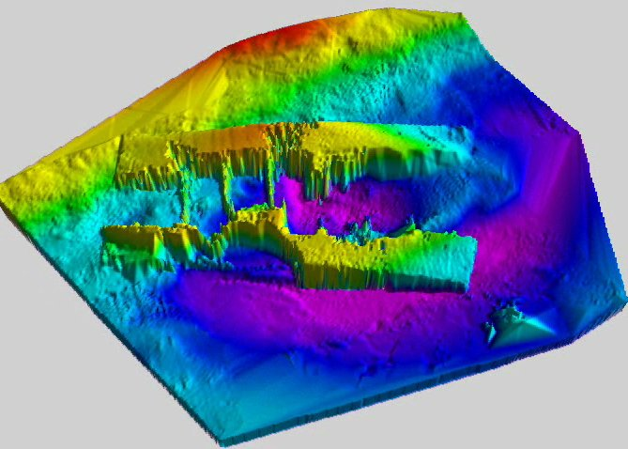
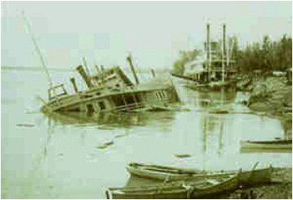
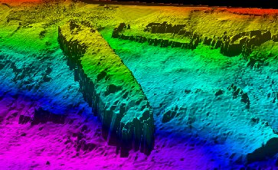
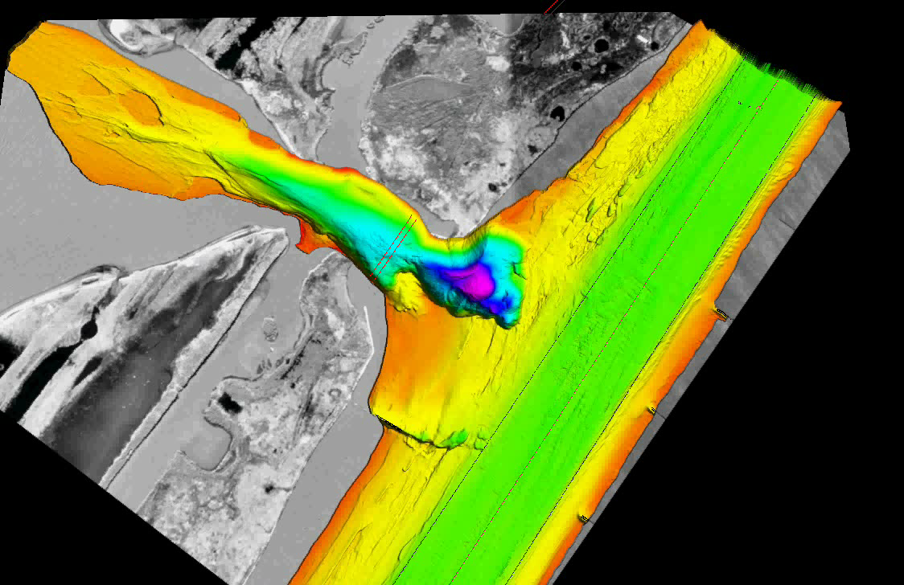
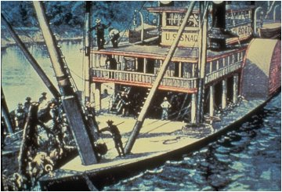
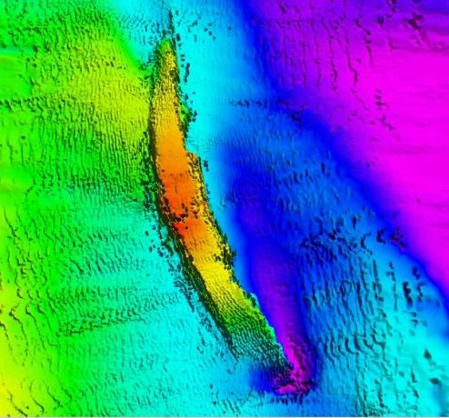
Wrecks Analysis

Slide 8
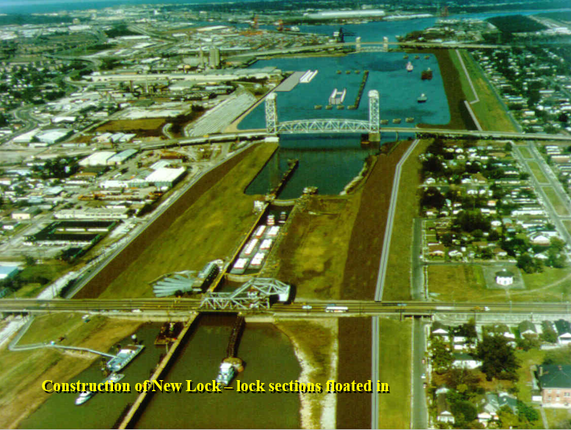
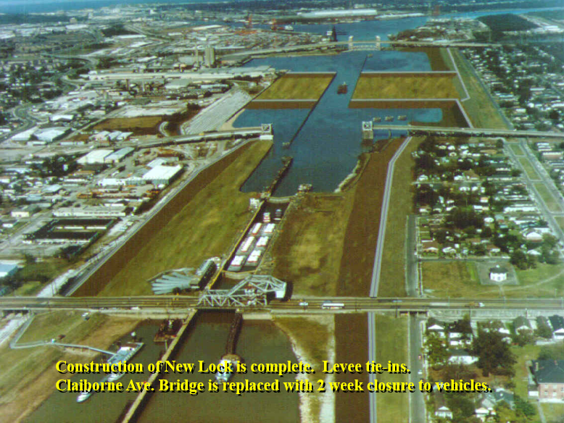
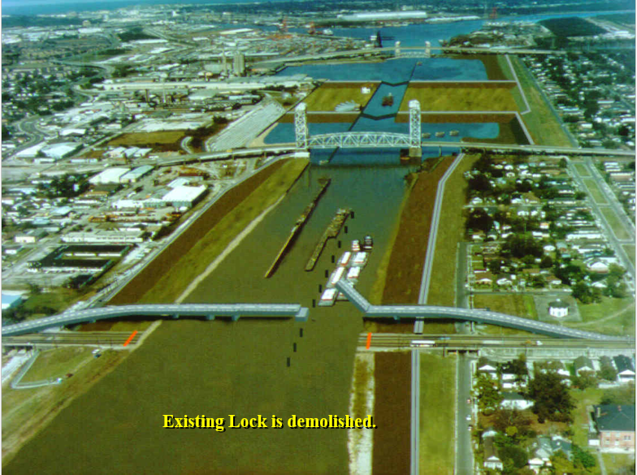
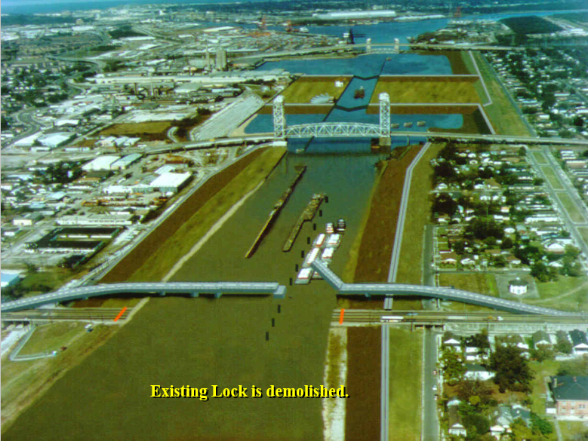
IHNC Lock Visualization

Slide 9
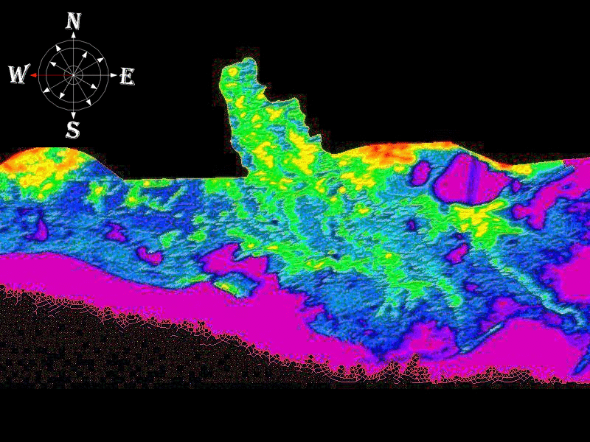
Terrain Roughness Coefficients

Slide 10
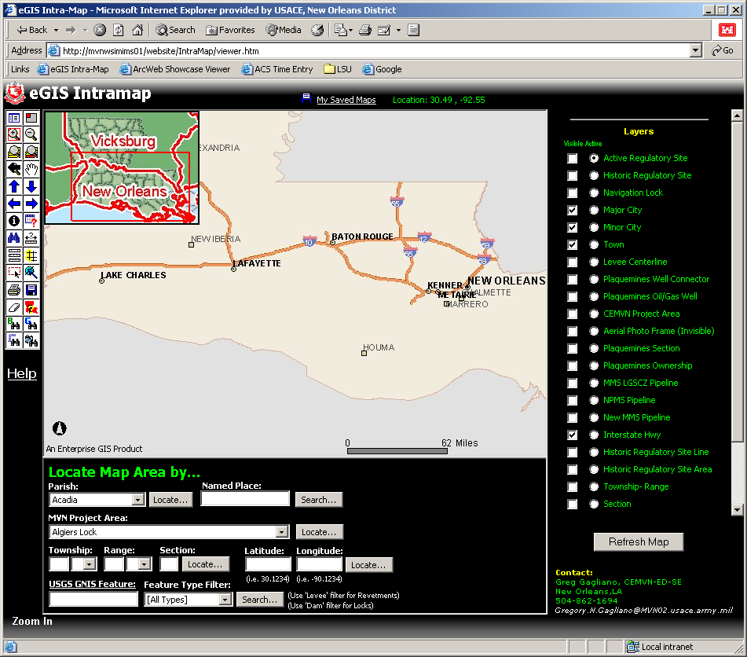
EGIS Intramap

Slide 11
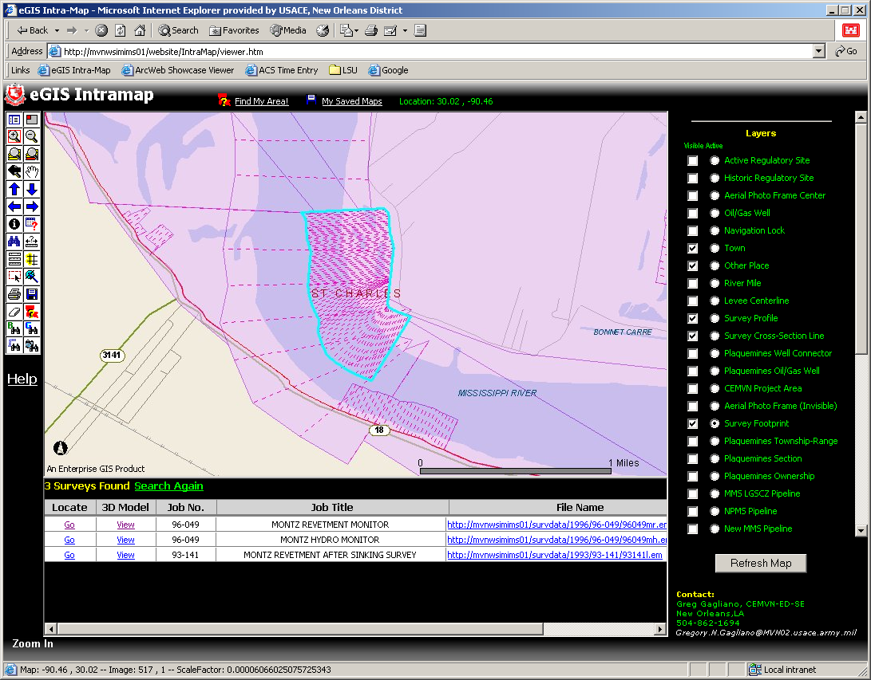
Intramap - Surveys

Slide 12
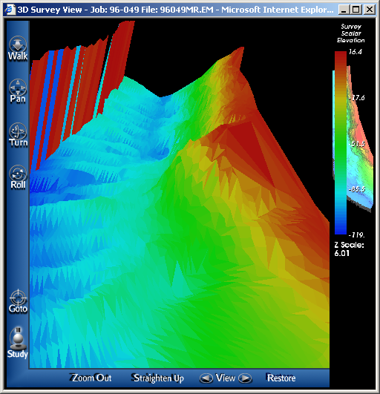
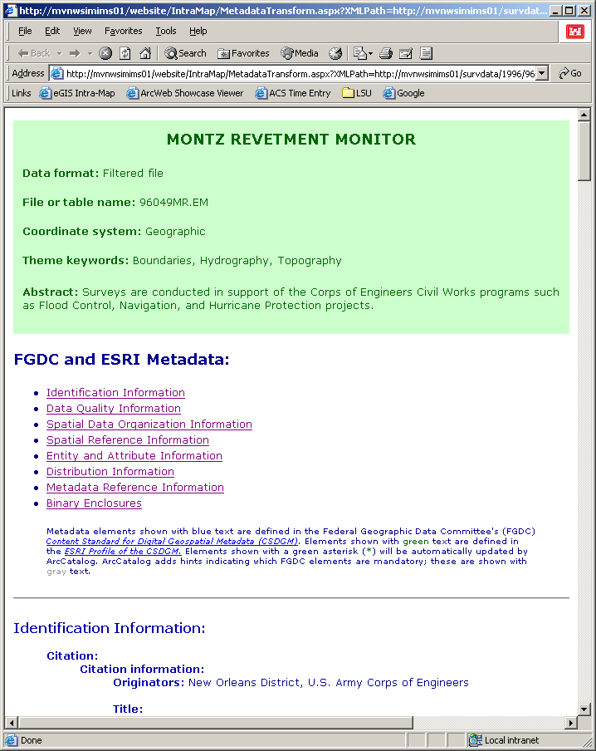
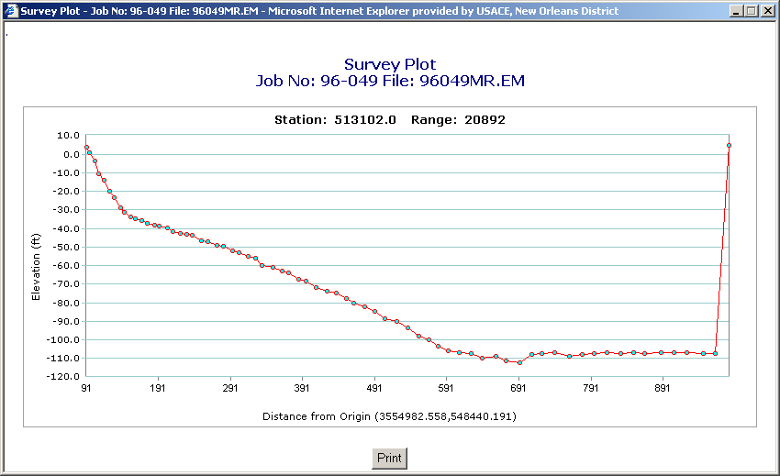
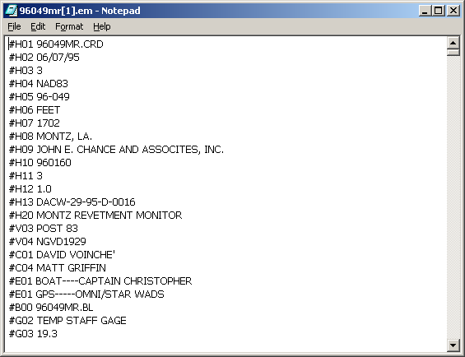
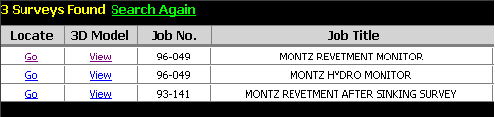
Survey Features
Metadata
3D Model
Cross-section Plot
EM File

Slide 13

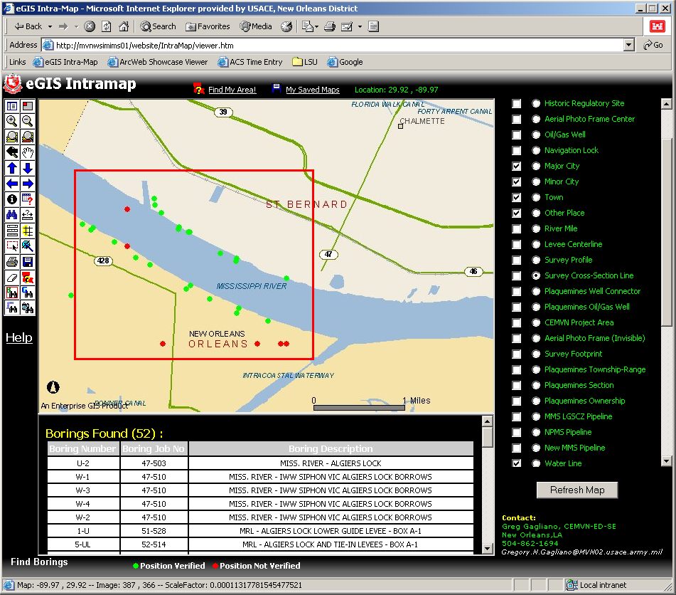
“Boring Find” Tool

Slide 14
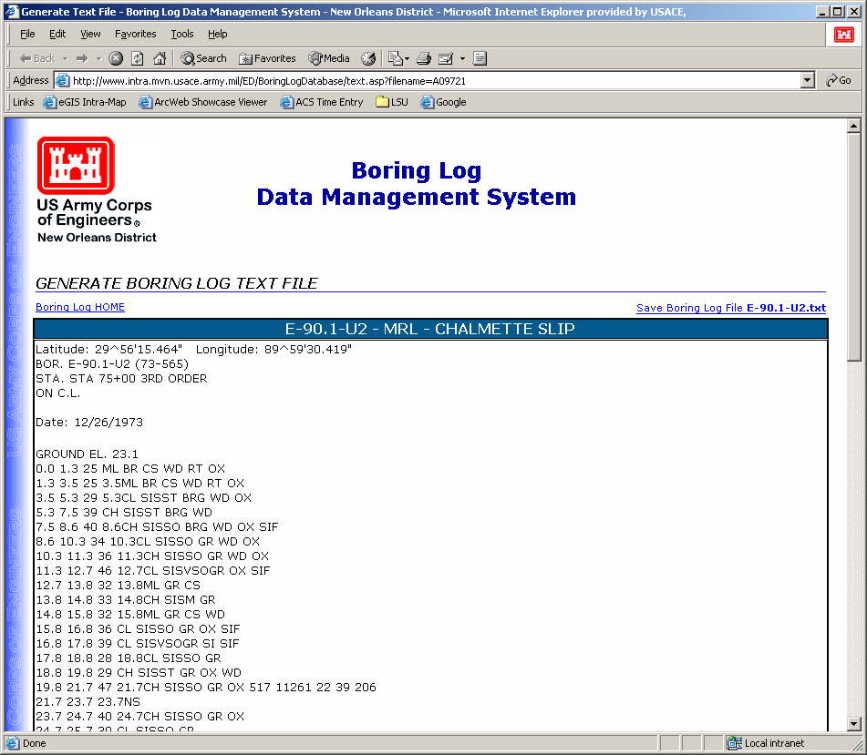
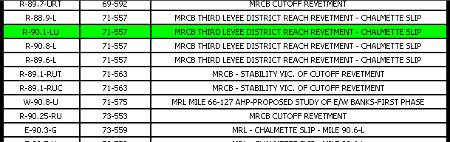
“Boring Find” Tool
Link to Boring Log Database Site

Slide 15
eGIS Data Layers

Slide 16

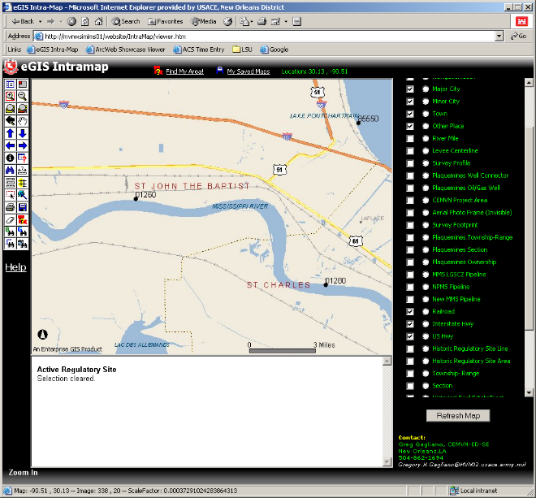
What Went Wrong
User Proficiency
User Interface Scaling
Performance Scaling
“Library Book” Effect
Commoditization

Slide 17
Intramap Lessons
Focus on workers, not leadership
Automate frequently-used workflows
Educate and empower users

Slide 18


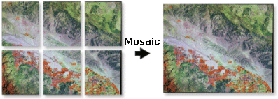
Centralize Data
(Instead of Application)
FREEBOARD
Database (Oracle)

Slide 19

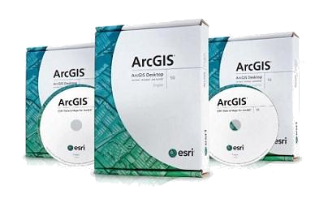
Deploy ArcMap to Users

Slide 20
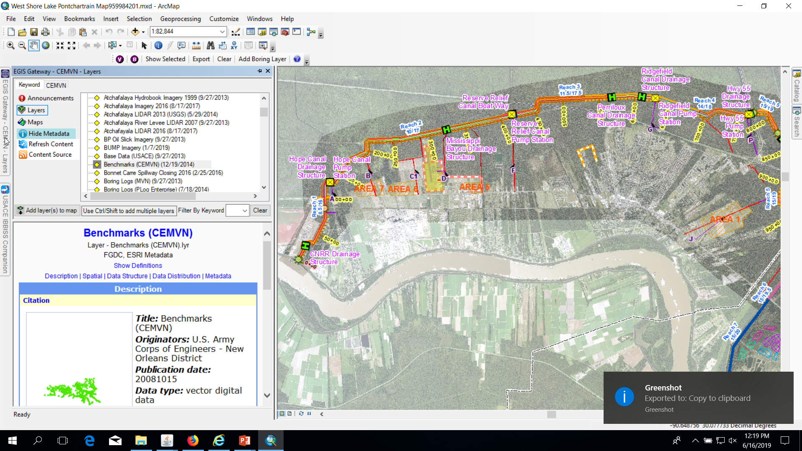
EGIS Gateway

Slide 21
ArcMap Addins
(Instead of Web Map Tools)

Slide 22

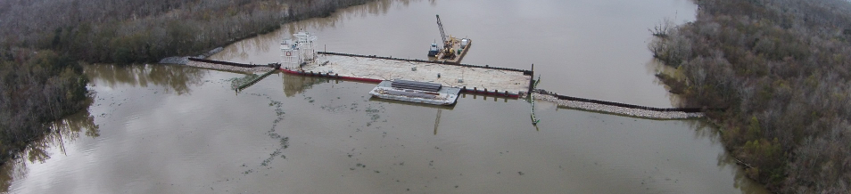
Improve Data Acquisition

Slide 23
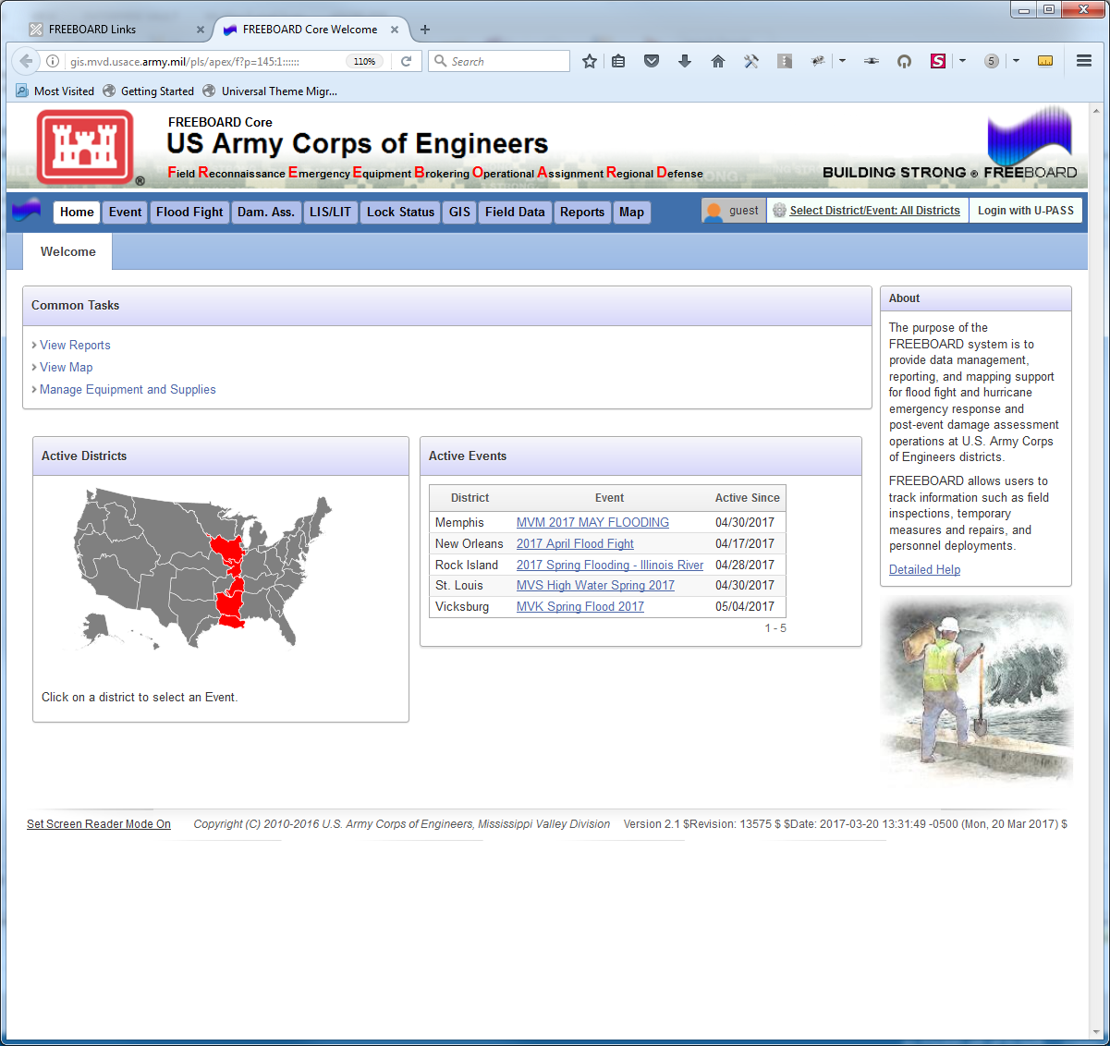
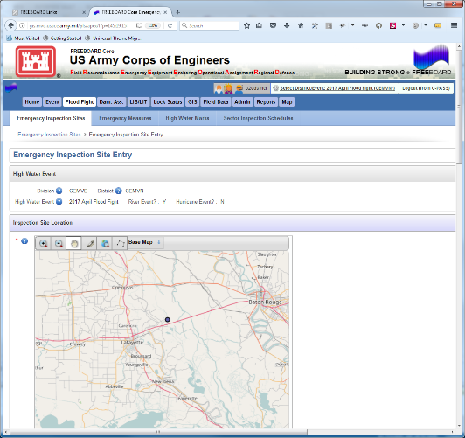
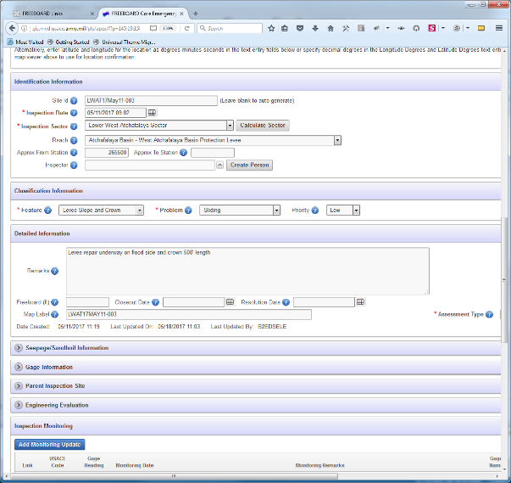
Web Applications
(Instead of Web Maps)

Slide 24


Fin

